Slide 1
Creep and Welding of CF8C-Plus and Modified Steels to Enable Commercial Licensing
Principal Investigator:P.J. Maziasz
Lead Division:Materials Science and Technology Division
Co-Investigators:B.A. Pint and N.E. Franco

Slide 2
Market Opportunity
Global market for high performance alloys is over $30 billion annually
CF8C-Plus steel and modified versions could be $3-4 billion over several years for widespread use for chemical/petrochemical, electric power (including gas- and steam-turbines) and transportation exhaust components.
Forecasts show high performance alloys to grow by 4-5% annually

Slide 3
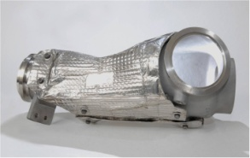
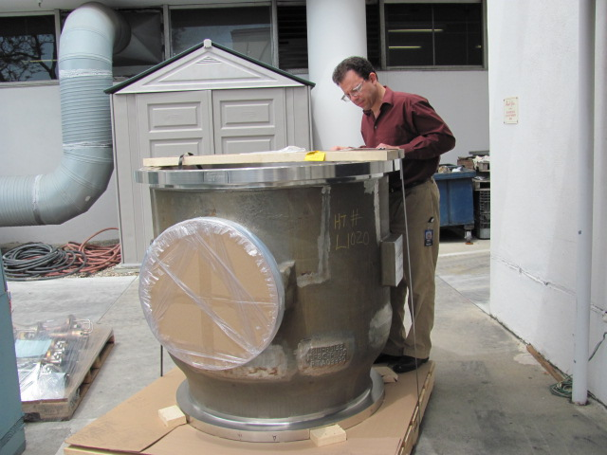
Technology Description – Castable CF8C-Plus Steel with Creep Strength at 600-900ºC Comparable to Ni-based Superalloys
CF8C-Plus is a new cast austenitic stainless steel developed by adding Mn and N to standard CF8C steel. It is very castable and requires no additional heat-treatment before service
28 lb Caterpillar regeneration system
(CRS) unit, cast by IMPRO, 550 tons
cast from 2006 - 2011
6,700 lb Solar Turbines Mercury 50 end-cover
Cast by MetalTek, 3 cast from 2005-2012, and one in the field

Slide 4
Technology Description – Castable CF8C-Plus Steel with Creep Strength at 600-900ºC Comparable to Ni-based Superalloy
Stronger!
Larson Miller Parameter (LMP) plot
of Creep Rupture at 550-850ºC
CF8C-Plus compares well with Ni-based
superalloy 617, which costs 7 times more

Slide 5
Technology Opportunity – CF8C-Plus steel
ARRA (Stimulus) CF8C-Plus deployment project:
  a) developed an ASME Code case (80% complete)
    Required for Boiler & Pressure Vessel applications
  b) performed preliminary welding studies
  c) developed new heats of CuW modified CF8C-Plus with more oxidation resistance at 800°C
TRL Level is 7-9, U.S. Patent 7,153,373 B2 (Dec.26, 2006), ASTM HG10MNN (2008)
Additional work is needed to:
  a) complete ASME Code Case testing & submit
  b) develop and test Fe-base filler welding for ASME
    Currently testing Ni-base weldments for ASME Code Case
  c) generate creep data on modified CF8C-Plus

Slide 6
Technology Opportunity – CF8C-Plus steel
The proof demonstrating that the technology works is the CRS commercialization application
The CRS unit regenerates the ceramic
diesel particulate filter (DPF) during
a 20 min burn cycle at 900ºC. 45,000
CRS units have operated on heavy-
duty truck diesels since late 2006
with no failures (>7y). This is proof of
creep and thermal fatigue resistance
and outstanding durability.

Slide 7
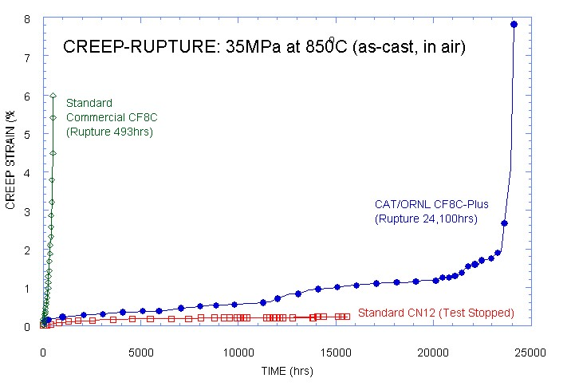
Technology Leadership – CF8C-Plus is unique because Mn and N additions create engineered microstructure for high temperature strength
Creep at 850ºC is the
performance indicator
that CF8C-Plus works
better than other
technologies

Slide 8


Competitive Differentiation
Technology Feature | ORNL Technology | Cast irons | Cast Stainless Steels | Cast Stainless Alloys | Ni-based superalloys
Creep resistance
Fatigue resistance
castability
weldability
cost
Operation up to 950ºC

Slide 9
Applications – Target Customers – Current Practice
 | Application Description | Target Customers | Current Practice
Pumps and valves | Components in power plants | Babcock&Wilcox, Alstom | 9-12Cr martensitic/ferritic steels
Gas -turbines | Turbine casing | General Electric, Siemens, Alstom | 9-12Cr martensitic/ferritic steels
Steam turbines | Turbine casing | General Electric, Siemens, Alstom | 2.25 or 9-12Cr martensitic/ferritic steels
Pumps, valves and piping | Components in chemical and petrochemical plants | Shell, Dow, Exxon Mobile, MetalTek, Duraloy | CF8, CF8C, CF10M, 347H, HK30Nb, HP40Nb, 800H
turbochargers | Turbo housing | Honeywell | Cast irons, HK30Nb
Exhaust manifolds | Diesel or gasoline Exhaust manifolds | Cummins, Ford, GM, Chrysler | Cast irons, HK30Nb

Slide 10
Contact information for CF8C-Plus steel
Dr. Philip J. Maziasz
Oak Ridge National Laboratory, P.O. Box 2008, ms-6115, Oak Ridge, TN 37831-6115
865 574-5082 ph
maziaszpj@ornl.gov

